Slide 1
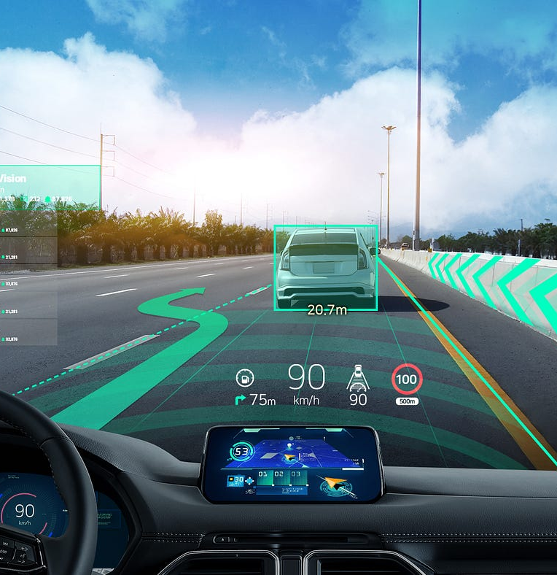




AI enabled visibility enhancements for driving
Author 1
Photo
Author 2
Photo
Author 3
Photo
Author 4
Photo
Dhanasri G
Abinaya A S
Darsini R
Dhanusha R
KONGU ENGINEERING COLLEGE
ERODE
MR B VIVEK

Slide 2
Challenge Statement
Poor visibility caused by fog, heavy rain or dust storms is a major factor in road accidents, as it makes it difficult for drivers to recognize obstacles and react in time.
Lack of visibility in such weather conditions poses a significant risk to road safety.
There is a serious risk to road safety when there are unclear visuals under such weather circumstances.

Slide 3



Concept / Solution
SOLUTION CONCEPT
BLOCK DIAGRAM
Developing a system to enhance driving visibility during adverse weather conditions like rainfall,fog and sandstrom using Raspberry Pi .
Integrating it with Radar Sensor, infrared sensors, and a Camera for comprehensive environmental data. Applies the Dark Channel Prior algorithm for effective removal of Fog.
We Use pre-processing techniques like contrast enhancement and histogram equalization. Employing YOLO models optimized with TensorFlow Lite for real-time hazard identification.
Displays processed visuals and alerts on a Head-Up Display for intuitive driver assistance.
Yolo V7-Obj detection
Image Processing and Dark channel prior
Raspberry Pi 4 Processing and deploying
IR sensor
Radar Sensor
Camera
HUD

Slide 4
Novelty / Scope of Solution
Traditional object detection models struggle in foggy or hazy conditions due to diminished image clarity, making it difficult to identify obstacles.
The proposed system addresses this challenge by combining deep learning models (like YOLO) with image enhancement techniques such as Dark Channel Prior .
This combination can significantly improve the reliability and speed of detection in adverse conditions, providing real-time hazard alerts even in severe weather.

Slide 5
Pros and Cons of the solution
PROS:
The system enables real-time object detection and visibility enhancement, making it suitable for autonomous vehicles and driver-assistance systems.
It can provide immediate feedback, alerting drivers to nearby hazards instantly.
CONS:
The system's performance depends heavily on the quality of the sensors and cameras used.
Real-time processing of image data, dehazing algorithms, and object detection models can be computationally intensive.

Slide 6
Technical Description
Raspberry PI 4
Camera
Radar sensor
Infrared camera
YOLO V7
Dark channel prior

Slide 7
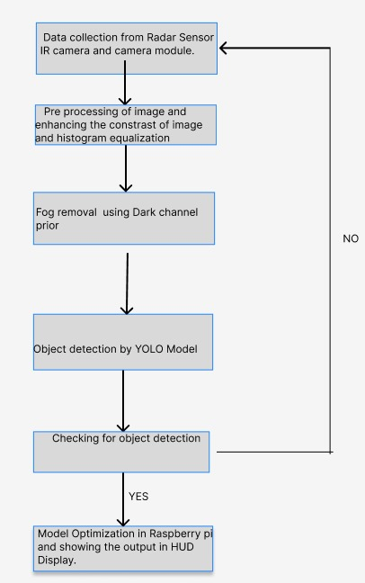
Implementation Plan
IMPLEMENTATION SUMMARY
FLOWCHART
Multi-Sensor Integration: Utilizes Radar sensor, infrared camera, and a camera to capture environmental data, improving visibility in low-visibility conditions such as fog, rain, or sandstorms.
Fog Removal: The Dark Channel Prior (DCP) algorithm processes the camera’s images to remove fog and haze, enhancing visual clarity.
Real-Time Object Detection: YOLO (You Only Look Once) algorithm detects and classifies obstacles (vehicles, pedestrians) in real-time from enhanced images.
Data Processing on Raspberry Pi: The Raspberry Pi 4 processes sensor data using AI algorithms, handling fog removal, object detection, and hazard identification.
Alert System: The system provides real-time hazard alerts through a Head-Up Display (HUD), improving safety in adverse weather

Slide 8
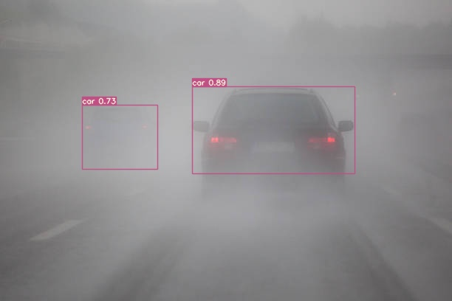
Validation / Testing / Analysis
Test result and proof of Yolo V7

Slide 9
Cost Estimate
Component | Approx. Cost
Raspberry Pi 4 | ₹4,000
Camera | ₹1,500
Radar Sensors | ₹1,200
Infrared camera | ₹600
HUD | ₹500
Total | ₹7,800

Slide 10
References
[1] Aubert, D.; Boucher, V.; Bremond, R.; Charbonnier, P.; Cord, A.; Dumont, E.; Foucher, P.; Fournela, F.; Greffier, F.; Gruyer, D.; et al. Digital Imaging for Assessing and Improving Highway Visibility; Transport Research Arena: Paris, France, 2014
[2] Martinez, J., & Gonzalez, F. (2009).Enhancing efficiency in autonomous driving using Al techniques Applications and advancements. AI and Autonomous Vehicles Review, 8(4), 167-179.
[3] Huang, S.-C.; Chen, B.-H.; Wang, W.-J. Visibility Restoration of Single Hazy Images Captured in Real-World Weather Conditions. IEEE Trans. Circuits Syst. Video Technol. 2014, 24, 1814–1824.

Slide 11
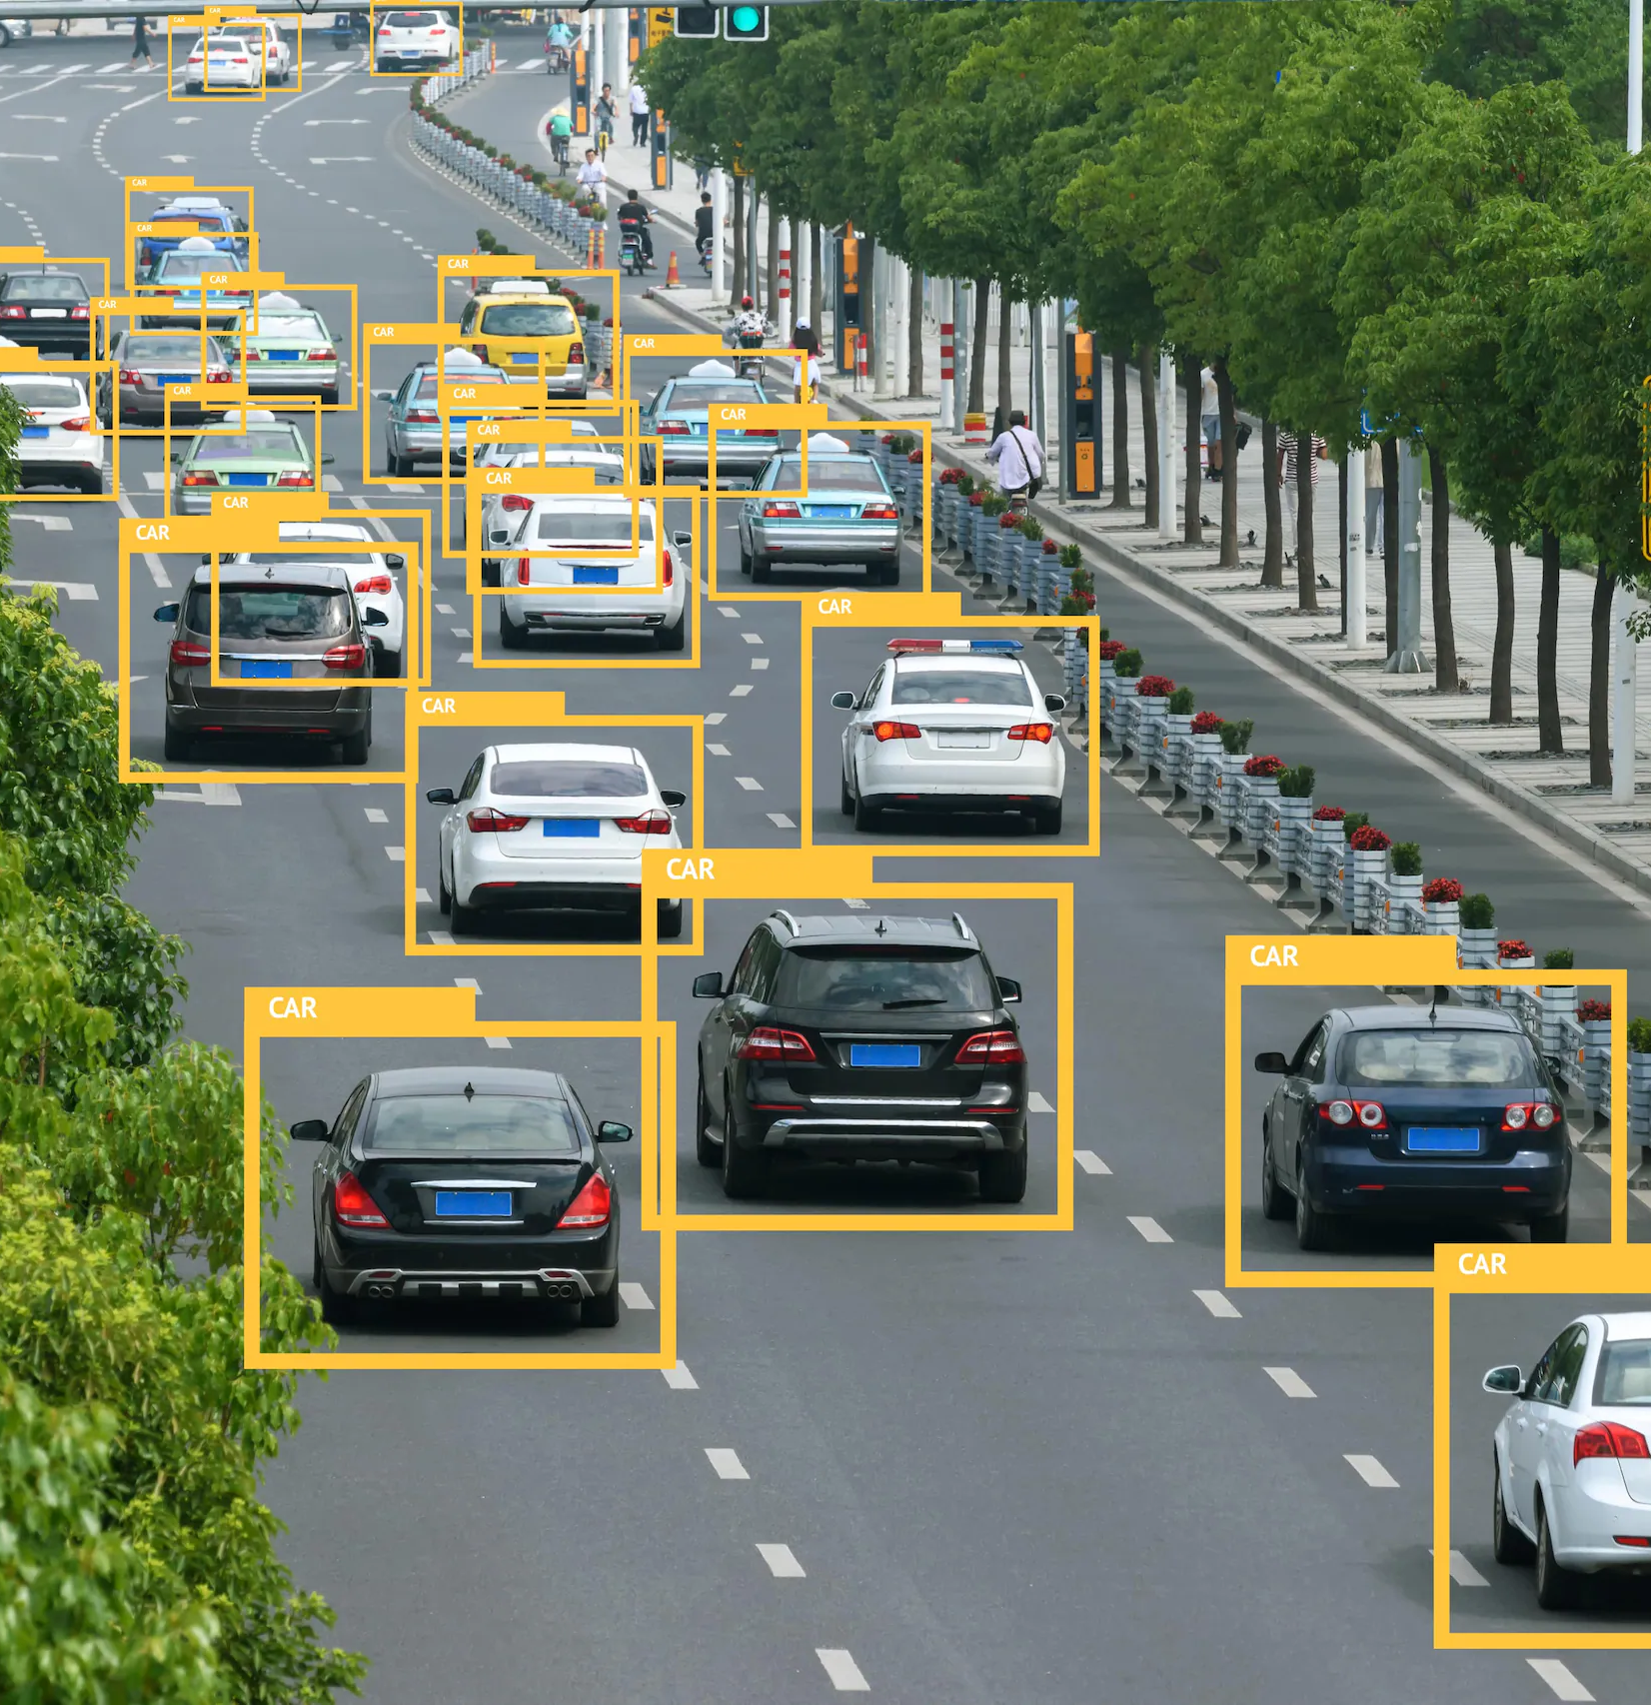
THANK YOU

